Slide 1
Weekly Update
2025.12.03
Hayeon Jeong

Slide 2
Table of Contents
CVPR 2026
UMM Unlearning
Plan

Slide 3
CVPR 2026 Submission
Previous Works cannot resolve this phenomenon?
More Training Experiments on More Classes/Instances
‘dvddog’ and more
Does size of the content in training data matters?
Temporal Analysis
Compared btw ‘Dominating’ and ‘Others’
Should be Compared btw ‘Dominanting’ and ‘Dominated’
Additional Experiments on SD2.1 (All Analysis Part)
Fine-tuning experiment
Focus score
Temporal Analysis
Head Ablation
Strengthen the minor argument
intra-category cosine distances – Try more training images
Head ablation - Others 카테고리에 대한 추가 분석
Dominated Token에 대해서 Layer 7를 추적하는 이유
Ablation Study (epsilon, LPIPS/SSCD threshold)

Slide 4
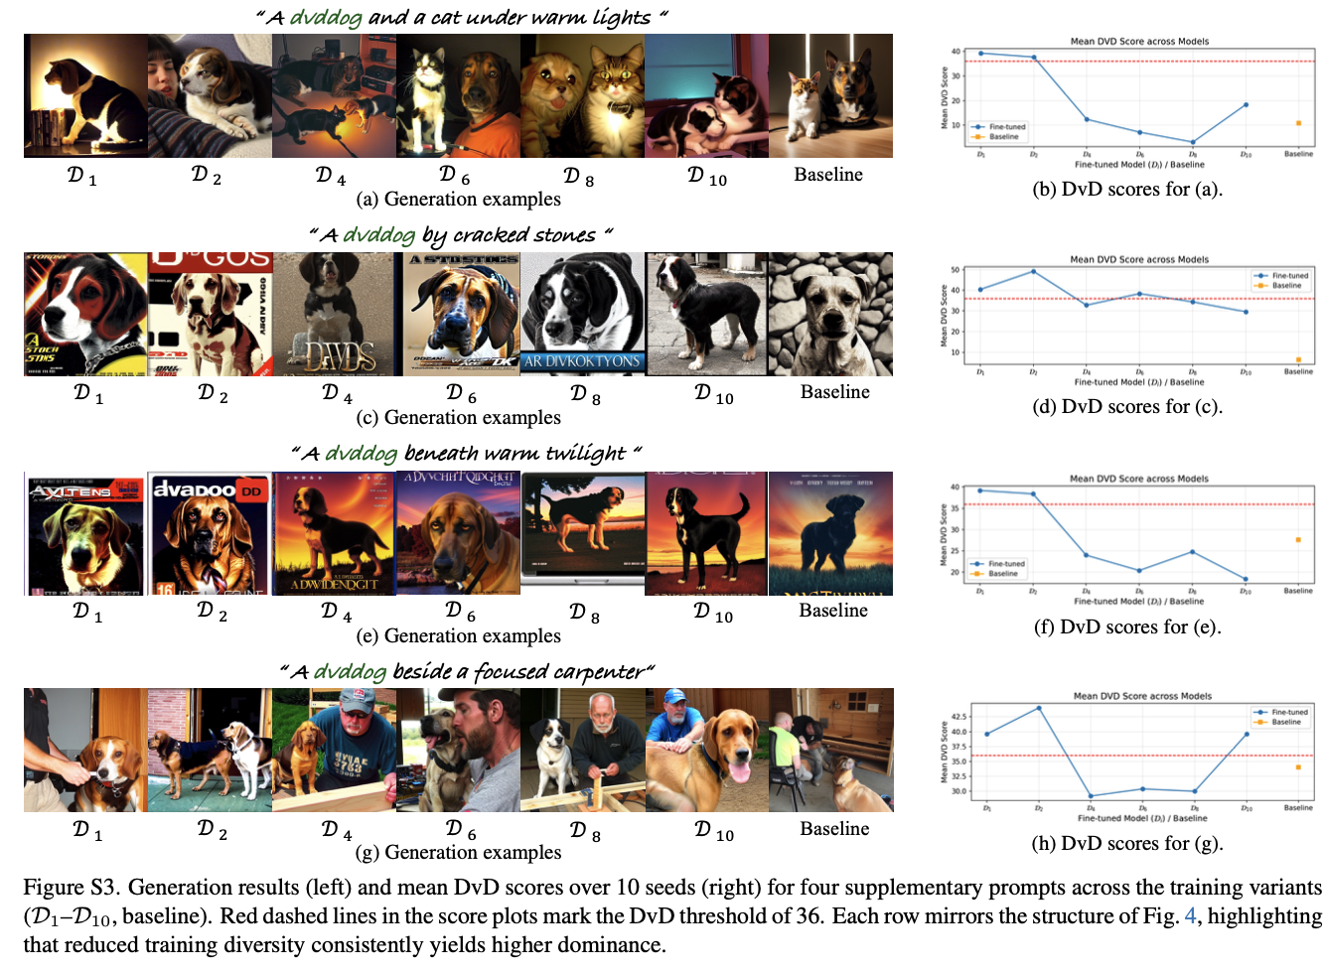
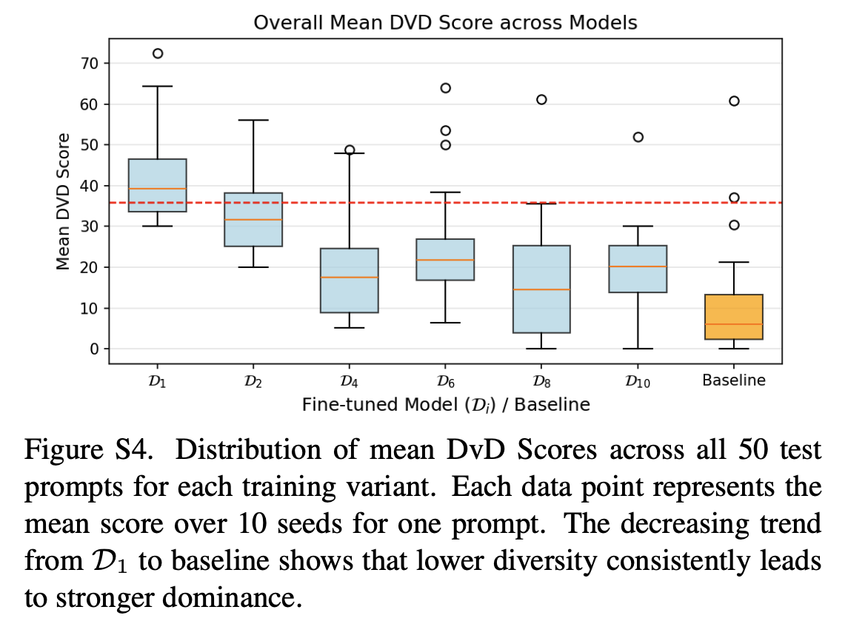
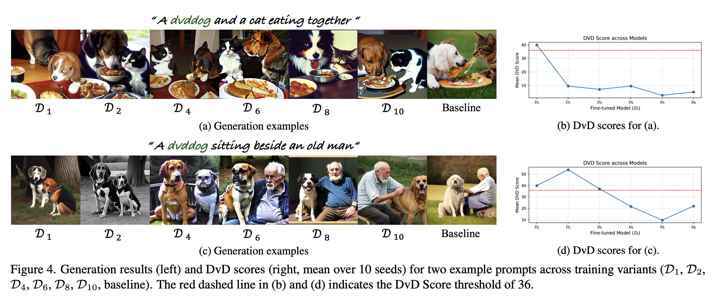
CVPR 2026 Submission
More Training Experiments on More Classes/Instances
Experimental Setup. We fine-tune SD 1.4’s UNet using DreamBooth [29] to learn a new concept token “dvddog” from 120 ImageNet [30] dog images. To systematically control visual diversity, we create six training variants by varying the number of dog breeds: D1,D2,D4,D6,D8,D10, where the subscript indicates the number of breeds. D1 uses all 120 images from a single breed (minimal diversity), while D10 uses 12 images from each of 10 breeds (maximal diversity).
Measure the similarity btw the training sets of D1,D2,D4,D6,D8, and D10, and construct the training set in a more systematic way. (or not?)
Train on more instances

Slide 5
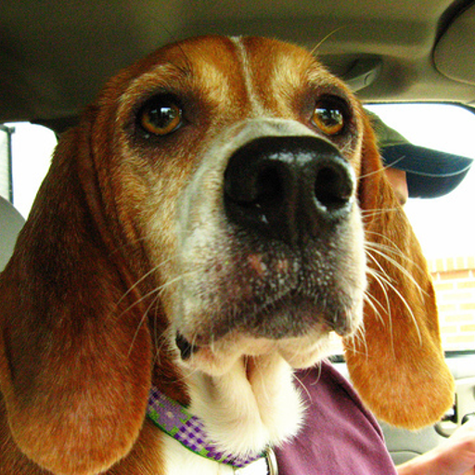
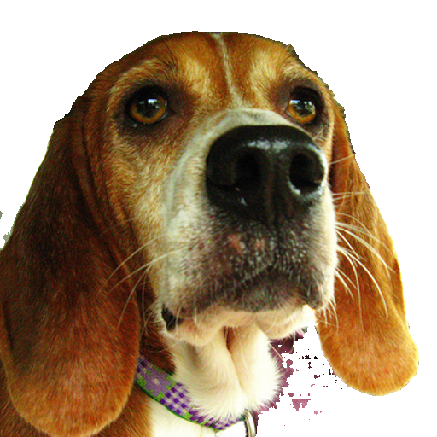
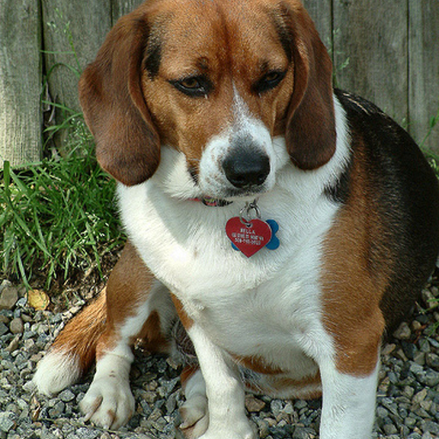
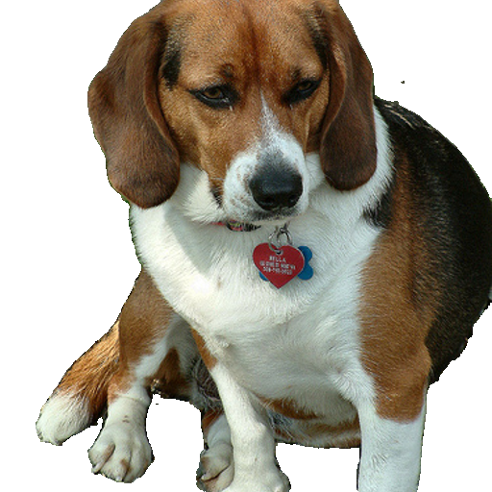
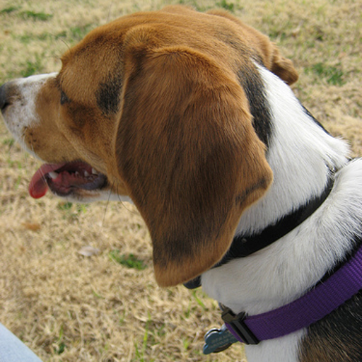
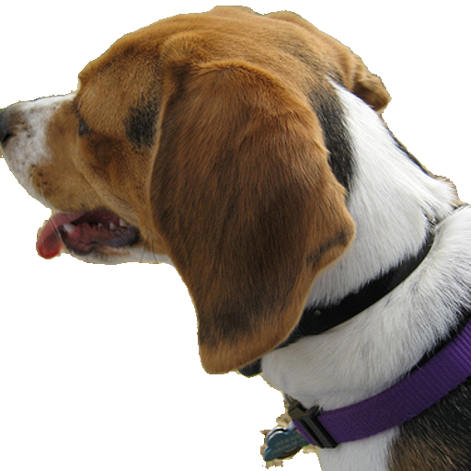
CVPR 2026 Submission
More Training Experiments on More Classes/Instances
Experimental Setup. We fine-tune SD 1.4’s UNet using DreamBooth [29] to learn a new concept token “dvddog” from 120 ImageNet [30] dog images. To systematically control visual diversity, we create six training variants by varying the number of dog breeds: D1,D2,D4,D6,D8,D10, where the subscript indicates the number of breeds. D1 uses all 120 images from a single breed (minimal diversity), while D10 uses 12 images from each of 10 breeds (maximal diversity).
Does size of the content in training data matters?
Sementation by SAM3
(threshold = 0.4)

Slide 6
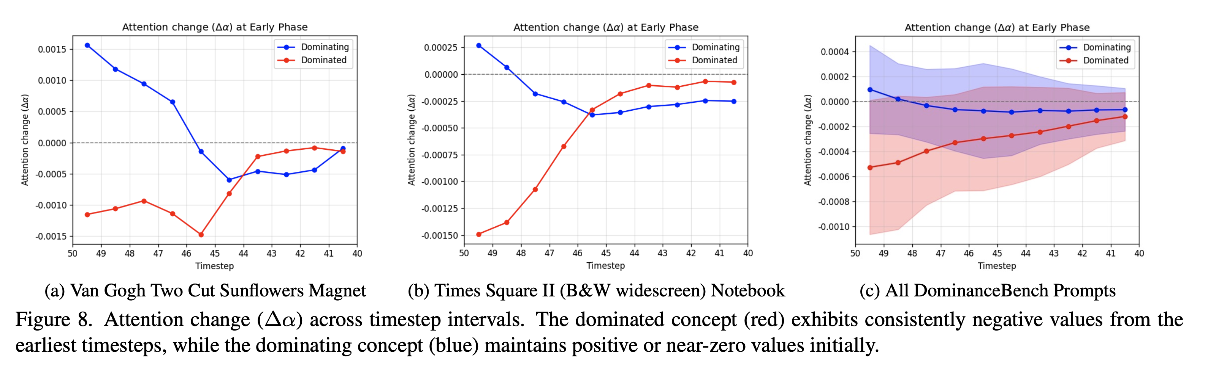
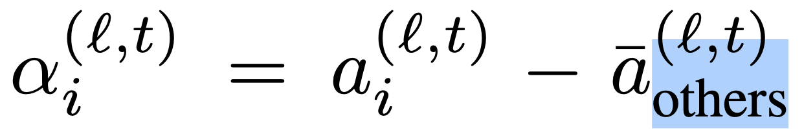
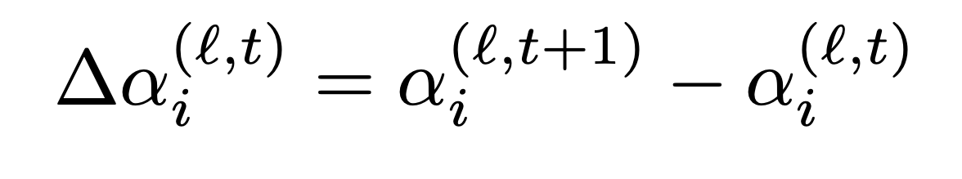
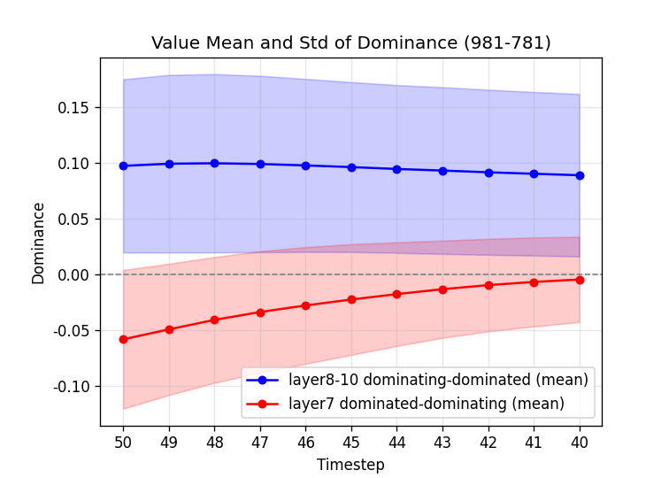
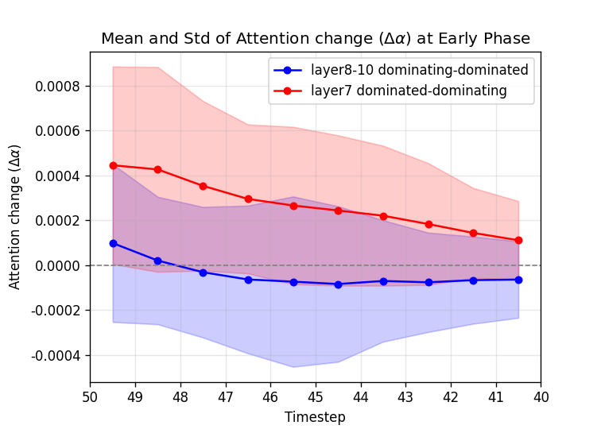
CVPR 2026 Submission
Temporal Analysis
Compared btw ‘Dominating’ and ‘Others’
Should be Compared btw ‘Dominanting’ and ‘Dominated’?

Slide 7
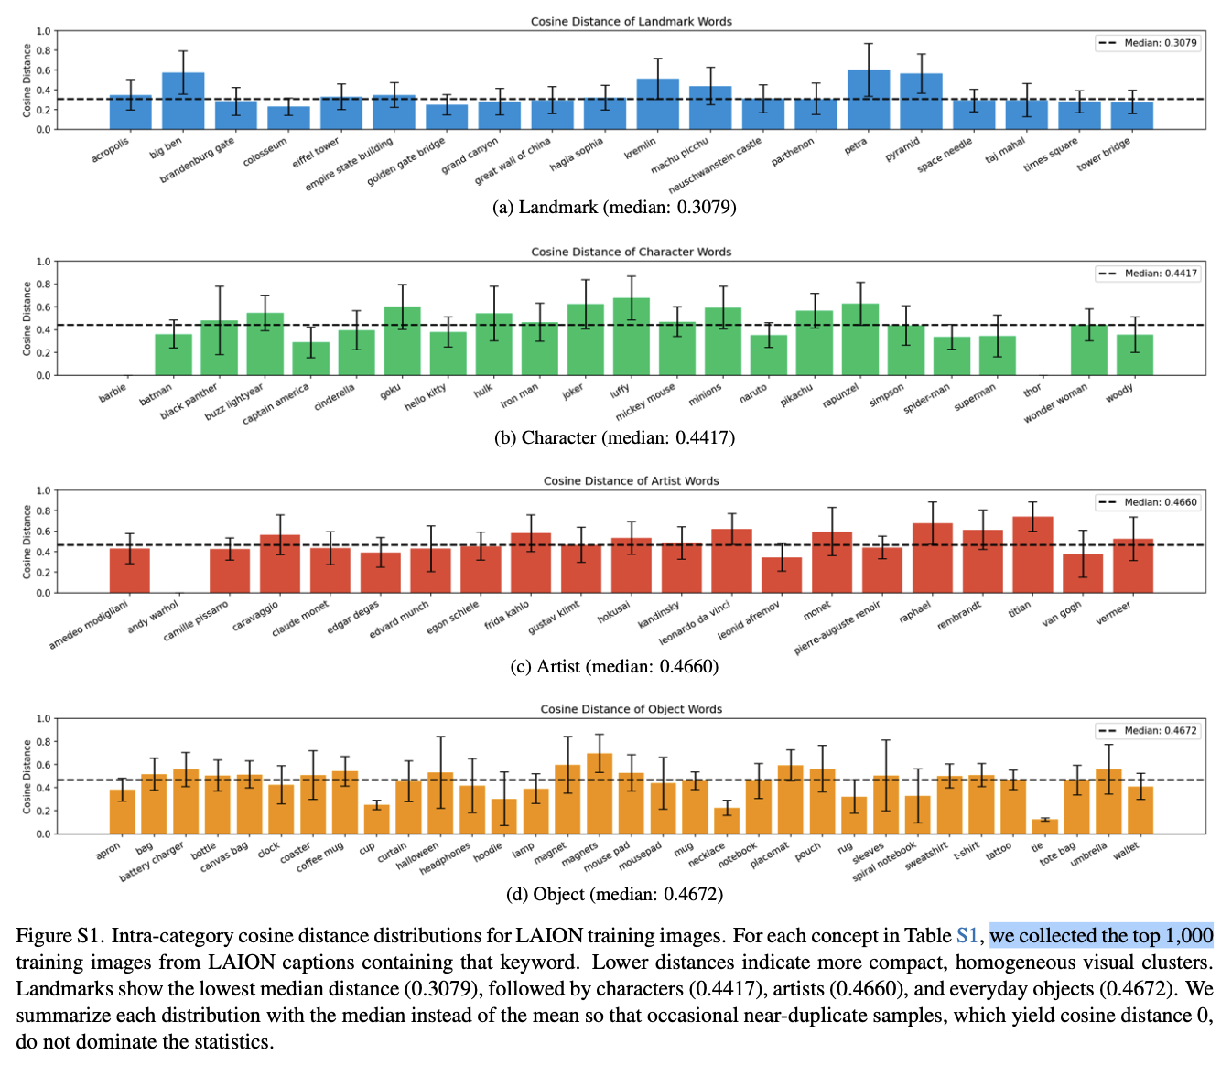
CVPR 2026 Submission
Strengthen the minor argument
To quantify visual diversity, we collect LAION training images associated with the top-k most frequent prompts per concept keyword. We first rank all LAION captions (length 20–100 characters) that contain the keyword, keep the top-k prompts, and download the training images linked to those prompts via their URLs. We then compute CLIP ViT-L/14 image embeddings and measure intra-category cosine distances to assess visual compactness.
Try more training images

Slide 8
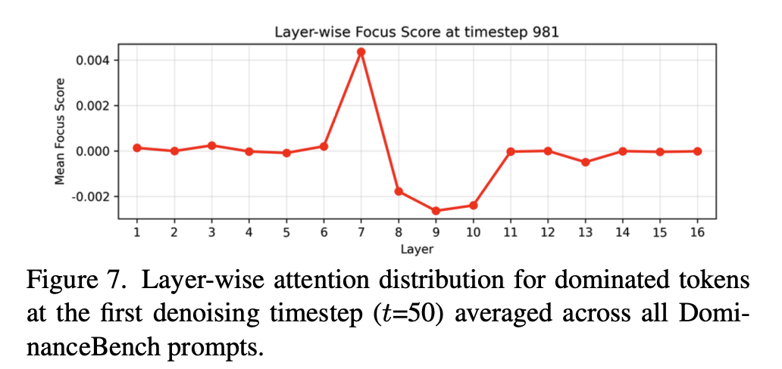
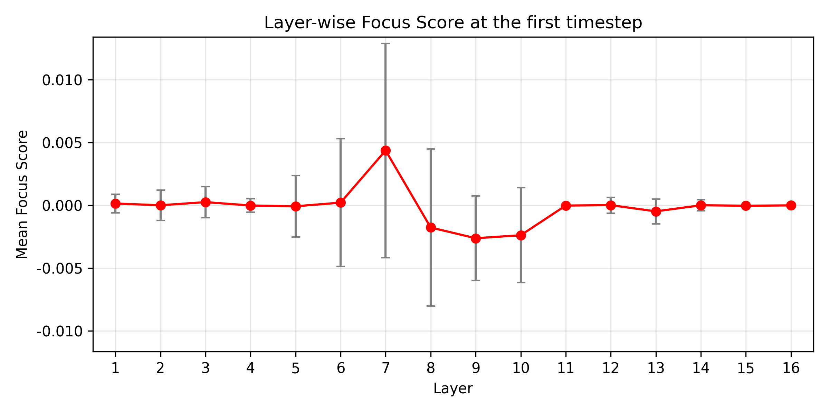
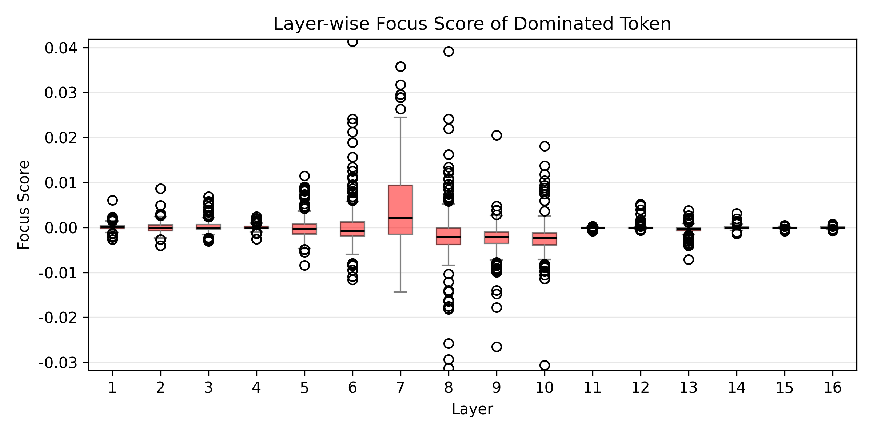
CVPR 2026 Submission
Strengthen the minor argument
To understand the temporal dynamics of both concepts, we track each token at the layer where it exhibits peak attention concentration. For the dominating concept, we examine lower-resolution layers (layers 8–10) where high focus scores were observed (Sec. 4.2.1). For the dominated concept, we track layer 7, where the dominated token’s attention exhibits the highest focus score (Fig. 7).
Dominated Token에 대해서 Layer 7를 추적하는 이유를 Fig.7을 기반으로 제시했지만, 조금 더 구체적 근거가 필요하지 않을지
문제점: 표준편차 - 매우 큼
대안: DvD 프롬프트의 대다수(ex. 80% 이상)에서 Dominated Token이 실제로 layer7에서 peak attention을 보임을 증명
layer7에서 nm_word 토큰이 최대 attention인 case 수: 155/300
비율: 51.67%
------------------------------------------------------------------------------
layer5-10 범위에서 nm_word 토큰이 최대 attention인 case 수: 194/300
비율: 64.67%

Slide 9
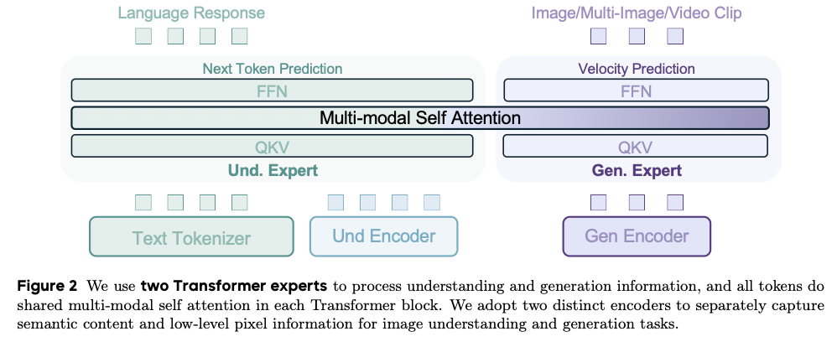
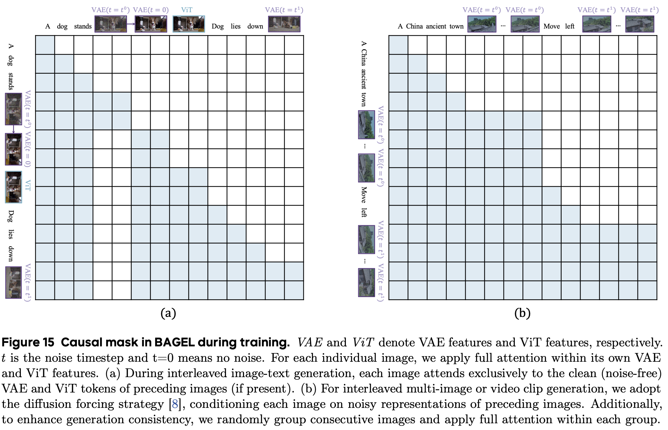
UMM Unlearning
Emerging Properties in Unified Multimodal Pretraining (ByteDance, May 2025, BAGEL)

Slide 10
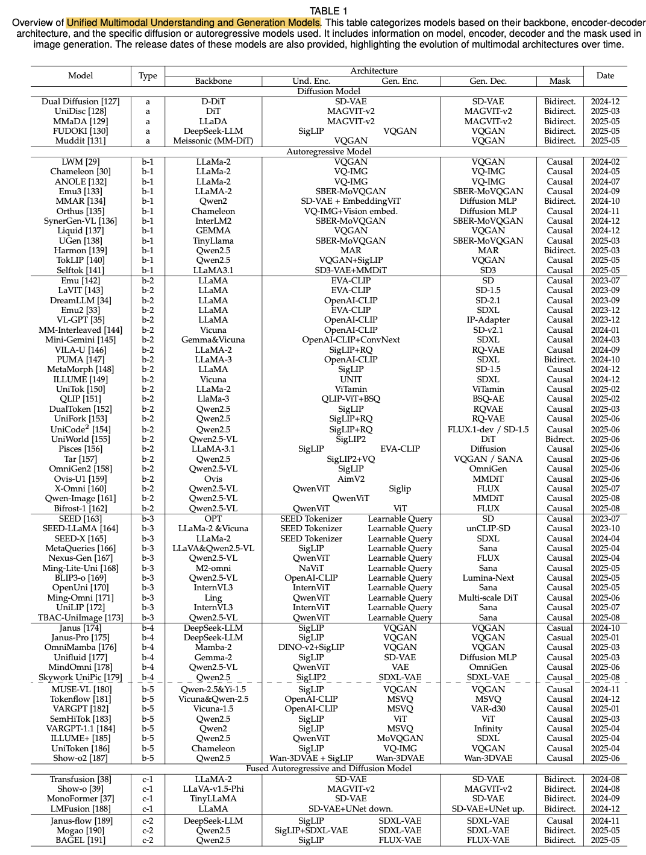
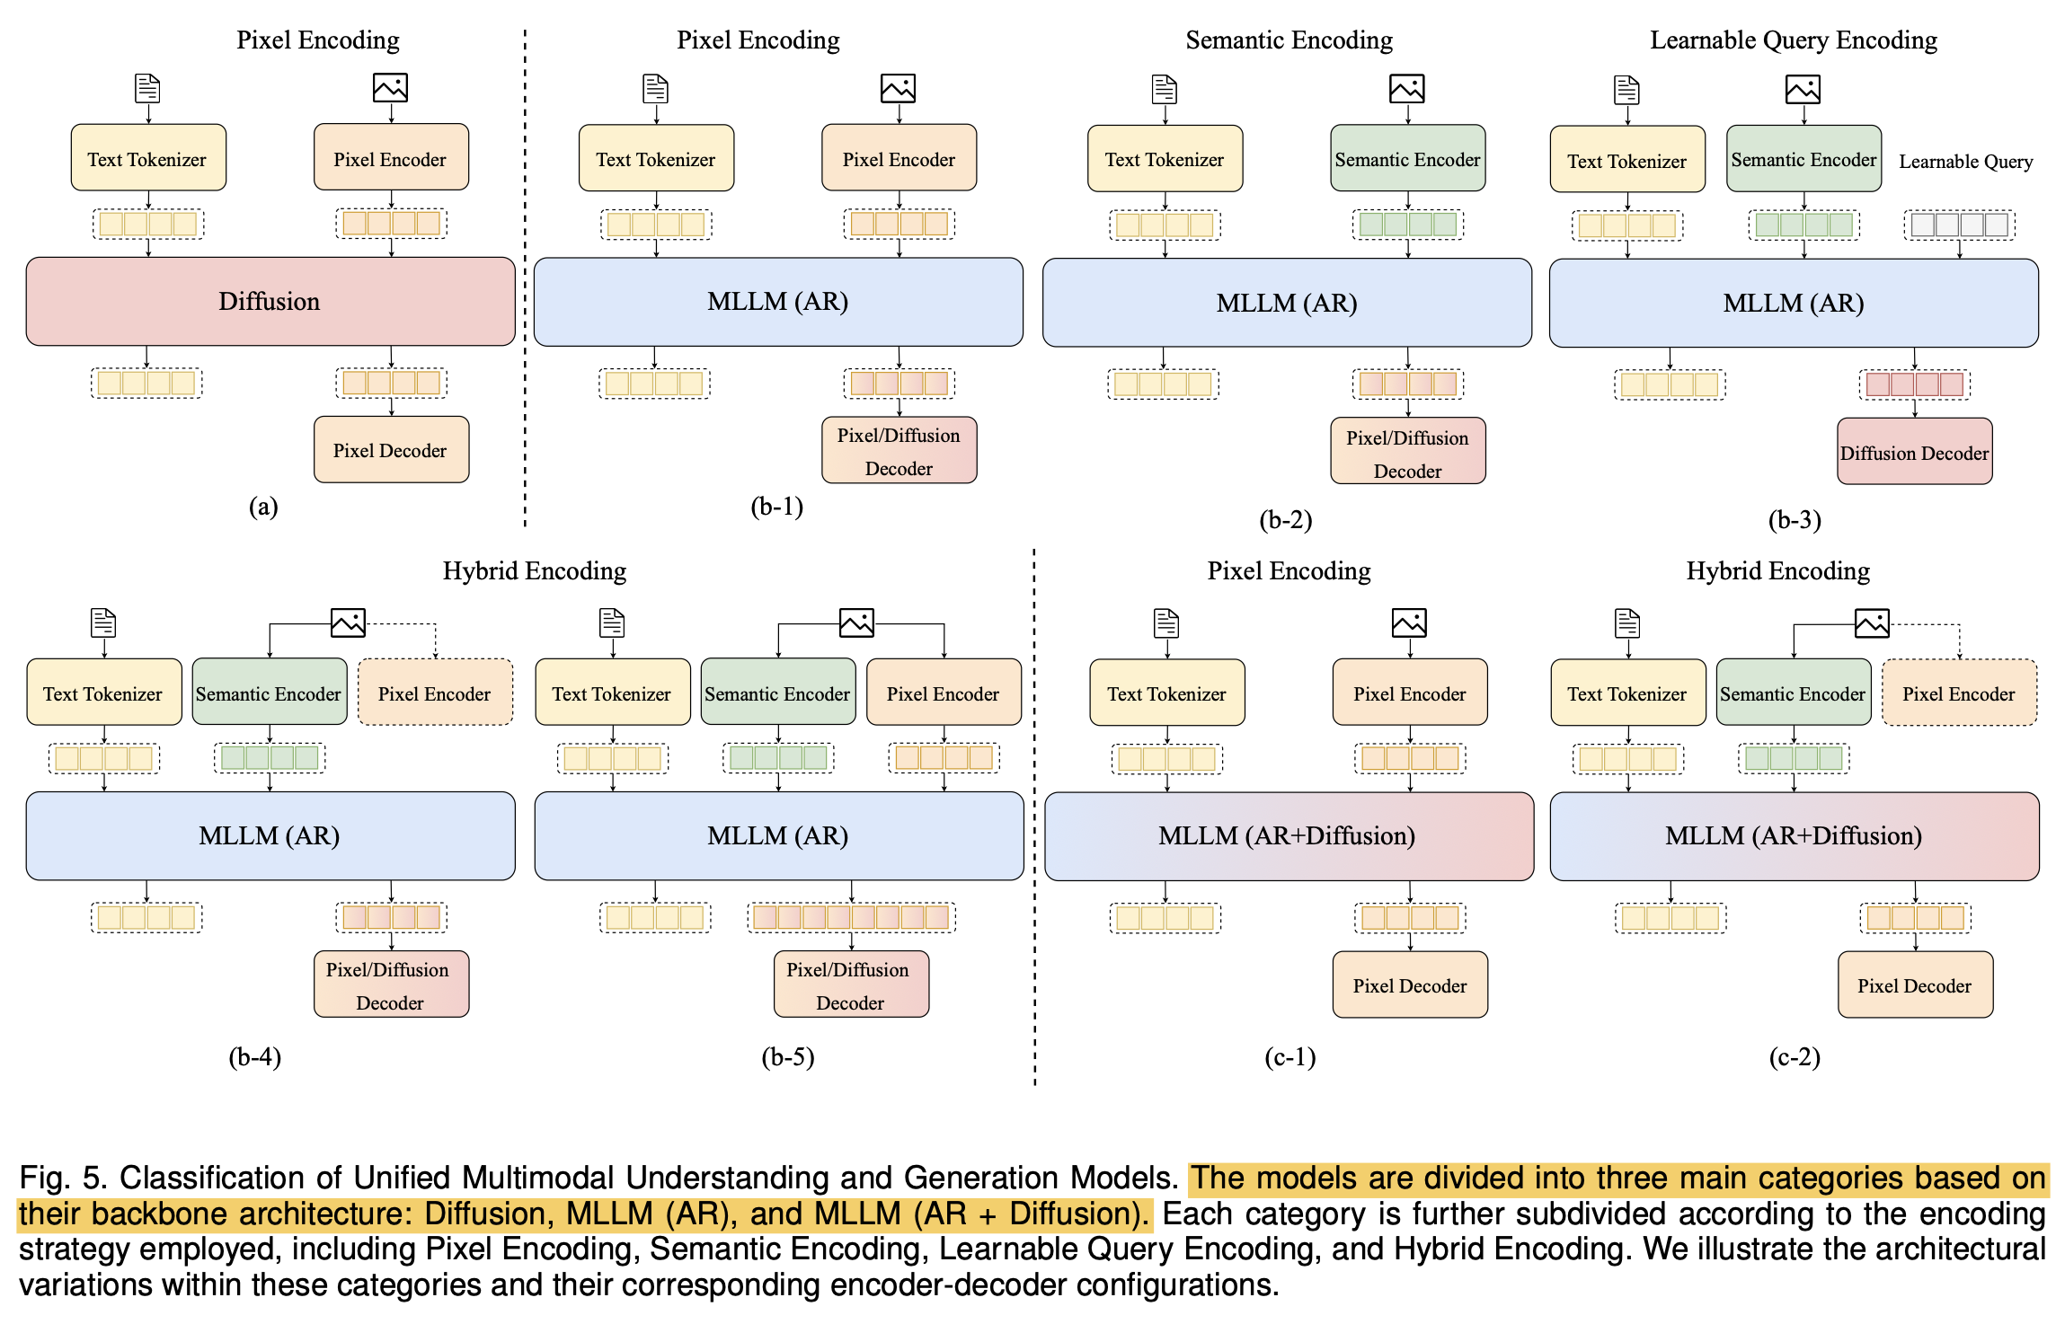
UMM Unlearning
Unified Multimodal Understanding and Generation Models- Advances, Challenges, and Opportunities
*EraseAnything- Enabling Concept Erasure in Rectified Flow Transformers

Slide 11
UMM Unlearning
Generation Unlearning in Diffusion Models
Generation Unlearning in Autoregressive Models
Generation Unlearning in UMM (similar as the research above)
LLM Unlearning → how generation changed?
In the “thinking” mode…

Slide 12
* Plan
Memorization
Previous Works cannot resolve this phenomenon?
More Training Experiments on More Classes/Instances
‘dvddog’
Temporal Analysis
Compared btw ‘Dominating’ and ‘Others’
Should be Compared btw ‘Dominanting’ and ‘Dominated’
Additional Experiments on SD2.1 (All Analysis Part)
Fine-tuning experiment
Focus score
Temporal Analysis
Head Ablation
Strengthen the minor argument
Unlearning
UMM, Autoregressive Models
Unlearning Methods in Diffusion
Milestone
Rebuttal (Jan, 22, 2026) – 7 weeks
UMM Unlearning

